Slide 1
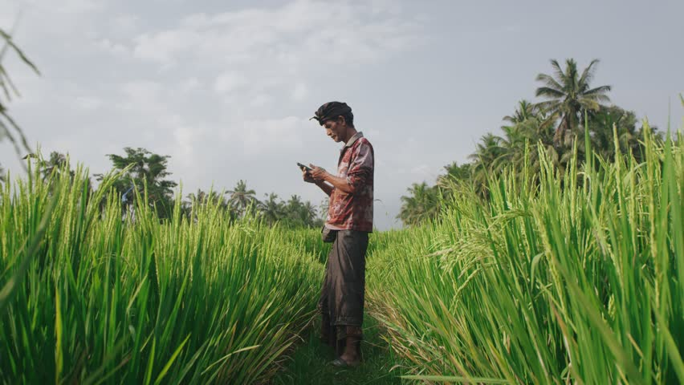
CROP GUIDANCE & FARMERS FRIEND
Presented by:
CODE BLOODED

Slide 2

PROBLEM STATEMENT
Helping the farmers in terms of Crop suggestion, precautions based on the met department forecast of rain fall / weather, potential pest attacks , weather warnings etc.

Slide 3
PROBLEM IN DETAIL
System that provides details to farmers on weather patterns that could impact the crop , possible pest attack , weather warnings.
Steps for producing high yield that are specific for a farmer based on local , regional terrain , weather scenario , rather than generic guidance.
Helping farmers to be well prepared if there is pest , insect attack.
Better farmer financial inclusion for planning out loans ,interests and managing costs.

Slide 4
SOLUTION
Register Interface for farmers which is one time activity where farmer can register via mobile phone.
Crop suggestion based on weather.
Broadcast update from government agencies when there is major pest attack or there is a flood warning attack to the farmer who can really look it and take right precaution , the broadcast can be in the form of SMS.
Multilingual support so that farmers across different cities and states can use it easily.
‘Ask a question’ interface as intelligent as a boat based on query respond type in it could give them the information at the tip.

Slide 5
TECHNOLOGY TO BE USED
Language
Python
Framework
Bootstrap, Django
Database
sqlite3

Slide 6
BENEFITS OF SOLUTION
For farmers, pesticide firms, Govt agencies helping farmers, Agriculture loan banks.
How Does it Help the nation?
Better crop produce and farmers have better income.
High yield and perspective guidance.

Slide 7

THANK YOU

